Slide 1


Hosting a PHP Website on Amazon EC2
In this presentation, we'll explore the process of hosting a PHP website on Amazon Elastic Compute Cloud (EC2), a powerful cloud computing service provided by Amazon Web Services (AWS).
BY GROUP 18
PS
Notes:
1

Slide 2

Introduction to Amazon Web Services (AWS)
1
Comprehensive Cloud Platform
2
Global Infrastructure
AWS has a vast global network of data centers, providing reliable and scalable cloud infrastructure.
AWS offers a wide range of cloud computing services, including storage, computing, networking, and more.
3
Diverse Service Offerings
AWS provides a variety of services, such as EC2, S3, RDS, and Lambda, to meet different business needs.
Notes:
2

Slide 3
Overview of Amazon Elastic Compute Cloud (EC2)
Scalable Computing Power
Flexible Pricing Options
Seamless Scaling
EC2 allows you to launch and manage virtual servers, known as instances, with customizable hardware and software configurations.
EC2 offers several pricing models, including on-demand, reserved, and spot instances, to suit your budget and usage needs.
You can easily scale your EC2 resources up or down, ensuring your website can handle fluctuating traffic demands.
Notes:
3

Slide 4

Key Features of Amazon EC2
Compute Power
Storage Options
EC2 offers a wide range of instance types with varying CPU, RAM, and storage configurations to match your workload requirements.
EC2 supports various storage options, including Elastic Block Store (EBS) and Amazon Elastic File System (EFS), to meet your data needs.
Network Connectivity
Security
EC2 instances can be connected to Amazon Virtual Private Cloud (VPC) for secure and customizable network configurations.
EC2 provides robust security features, such as security groups, key pairs, and IAM roles, to protect your instances.
Notes:
4

Slide 5
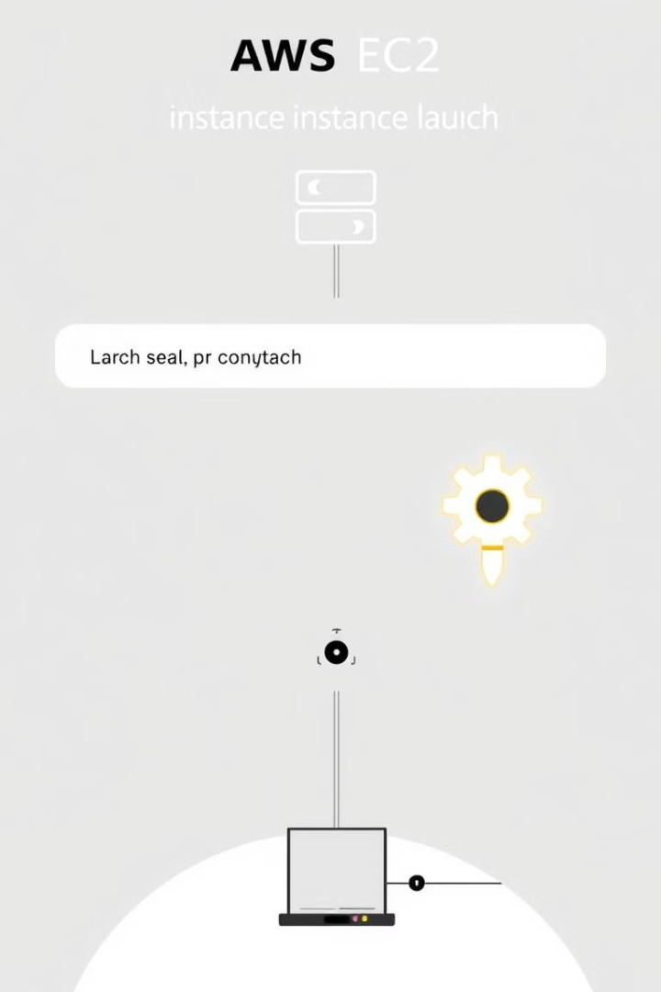
Launching an EC2 Instance
Instance Selection
1
Choose the appropriate EC2 instance type based on your website's requirements and budget.
Configuration
2
Configure the instance's hardware, software, and network settings to suit your needs.
Security Setup
3
Establish security measures, such as security groups and key pairs, to protect your instance.
Notes:
5

Slide 6





Security Best Practices for EC2
Firewall Configuration
Data Encryption
Implement robust firewall rules to control inbound and outbound traffic to your EC2 instance.
Ensure data stored on your EC2 instance and in transit is encrypted to protect sensitive information.
Access Control
Regular Patching
Utilize strong authentication methods, such as IAM roles and key pairs, to control access to your EC2 instance.
Keep your EC2 instance and associated software up-to-date with the latest security patches.
Notes:
6

Slide 7
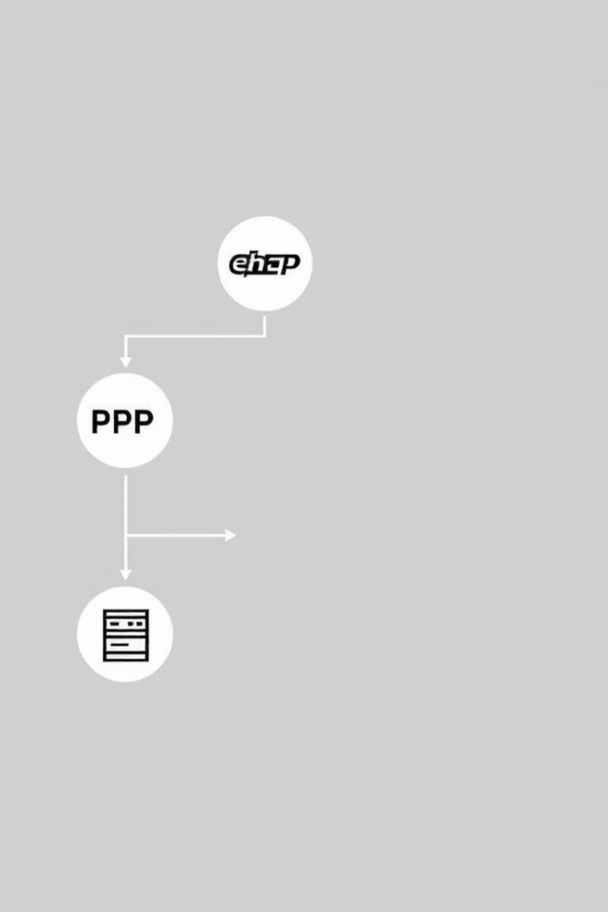




Configuring the EC2 Instance for a PHP Website
Install PHP
Set up the necessary PHP packages and dependencies on your EC2 instance.
Configure Web Server
Install and configure a web server, such as Apache or Nginx, to serve your PHP website.
Set Document Root
Specify the directory where your PHP website files will be stored on the EC2 instance.
Secure the Setup
Implement additional security measures, such as SSL/TLS encryption, to protect your PHP website.
Notes:
7

Slide 8

Deploying the PHP Website on the EC2 Instance
Upload Website Files
Transfer your PHP website files to the EC2 instance using a secure file transfer protocol, such as SFTP.
Configure Database
Set up a database, such as MySQL or PostgreSQL, and integrate it with your PHP application.
Test the Deployment
Thoroughly test your PHP website to ensure it is functioning correctly on the EC2 instance.
Monitor and Optimize
Continuously monitor your EC2 instance and website performance, making adjustments as needed.
Notes:
8

Slide 9

Conclusion and Key Takeaways
1
Scalable Infrastructure
2
Security Considerations
EC2 provides a scalable and flexible platform to host your PHP website, ensuring it can handle fluctuating traffic demands.
Implementing robust security measures, such as firewall configurations and access controls, is crucial for protecting your EC2 instance.
3
Seamless Deployment
The step-by-step process of configuring and deploying your PHP website on EC2 ensures a smooth and efficient hosting experience.
Notes:
9

